Slide 1
Primary Care Communications Toolkit
4 November 2020

Slide 2
Introduction
This toolkit has been created to provide the four independent contractor groups with information and assets to support them in communicating with their patients/customers:
Dental
GP Practice
Optometry
Pharmacy
The assets provided will help explain that services are still being delivered, but how they are being delivered has changed as a result of coronavirus.

Slide 3
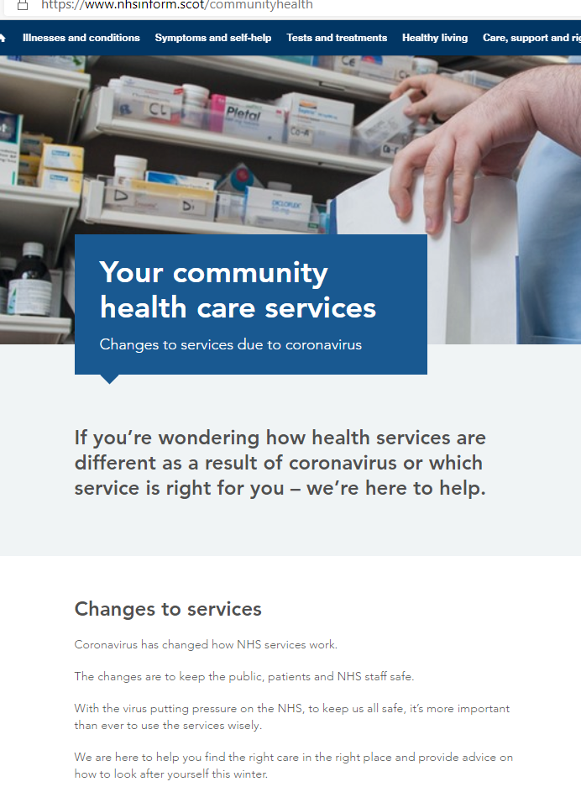
NHS Inform
A new landing page has been created on NHS Inform to provide this information for these groups:
https://www.nhsinform.scot/communityhealth
You can also find the new landing page in BSL format.

Slide 4
Dental
The following film has been added to NHSInform. This can be used through any digital communication channels you have available
You can also link directly to specific sections of the film via the following links:
EDIT 1: How do I make an appointment at my dental practice?
EDIT 2: What can my dentist help me with?
EDIT 3: How soon can I get an appointment?
EDIT 4: What health and safety measures are in place?
EDIT 5: Thank you for your patience and understanding
https://youtu.be/2BXCPJqIiqw
https://youtu.be/bMJpD43PqIU?t=11
https://youtu.be/bMJpD43PqIU?t=43
https://youtu.be/bMJpD43PqIU?t=55
https://youtu.be/bMJpD43PqIU?t=107
https://youtu.be/bMJpD43PqIU?t=155

Slide 5
Dental - Social Content
EDIT 1: How do I make an appointment at my dental practice?
POST 1: All dental practices are now open, and you can make an appointment by giving them a call. Find information on accessing dental services here: nhsinform.scot/dental
EDIT 2: What can my dentist help me with?
POST 2: Experiencing mouth pain or discomfort? All dental practices are now open and able to help. Find your nearest dental practice here: nhsinform.scot/scotlands-service-directory
EDIT 3: How soon can I get an appointment?
POST 3: Find out more how dental appointments are being managed to ensure those most in need of care are prioritised. For more information click here: nhsinform.scot/dental
EDIT 4: What health and safety measures are in place?
POST 4: Your dental practice will look a bit different to the last time you visited. Here, we explain what to expect so you can feel prepared and reassured. Find out more here: nhsinform.scot/dental
EDIT 5: Thank you for your patience and understanding.
POST 5: Changes to how dental services are delivered are there to protect you, your family and dental practice staff during the pandemic. Thank you for your patience and understanding. Find more information here: nhsinform.scot/dental

Slide 6
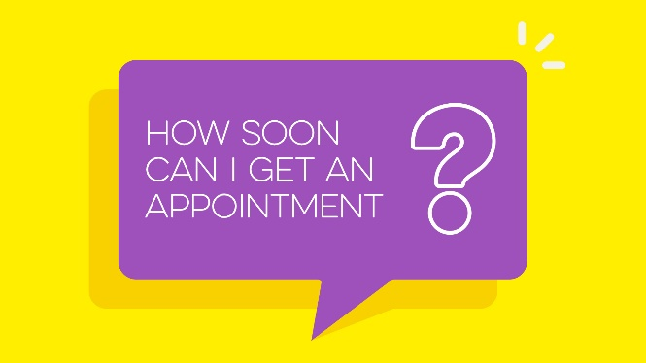
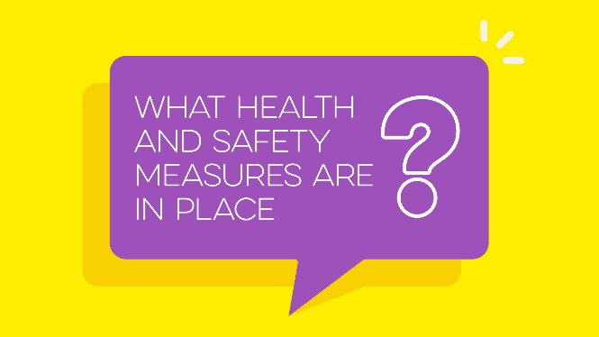
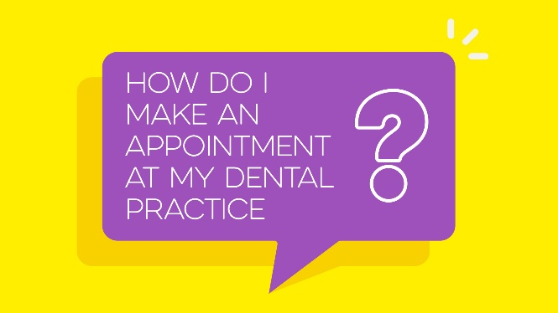
Dental - Images
Click here to download dental social images.

Slide 7
Dental - Copy
Coronavirus has changed the way all our health services work. All dentists are now open, but dental services will be delivered differently during the pandemic.
If you have any oral pain or something in your mouth your unsure about, call the dentist you’re registered with. The team will advise you about the options available and guide you to make sure you get the right treatment.
Due to physical distancing and infection control measures, dentists can only offer a certain amount of appointments each day, and priority will be given with urgent problems such as toothache.
When attending your appointment, your dental practice will look a bit different, but please follow the guidance to help reduce the risk of infection.
These changes are in place to protect you, your family and staff. Thank you for your patience and understanding.
For more information visit nhsinform.scot/dental

Slide 8
GP Practice
The following film has been added to NHSInform. This can be used through any digital communication channels you have available
You can also link directly to specific sections of the film via the following links:
EDIT 1: How do I make an appointment at my GP practice?
EDIT 2: Who will I see?
EDIT 3: Do I need to come in?
EDIT 4: How are GP practices keeping everyone safe?
EDIT 5: Why are some consultations by phone?
EDIT 6: Thank you for your patience and understanding
https://youtu.be/5hP9Yn5-zFE
https://youtu.be/5hP9Yn5-zFE?t=13
https://youtu.be/5hP9Yn5-zFE?t=53
https://youtu.be/5hP9Yn5-zFE?t=90
https://youtu.be/5hP9Yn5-zFE?t=128
https://youtu.be/5hP9Yn5-zFE?t=181
https://youtu.be/5hP9Yn5-zFE?t=225

Slide 9
GP Practice – Social Content
EDIT 1: How do I make an appointment with my GP practice?
POST 1: GP practices are open and here to help you. You can make an appointment by giving them a call or booking online. Find information on common symptoms and when to seek help here: nhsinform.scot/self-help-guides
EDIT 2: Who will I see?
POST 2: When you contact your GP practice, giving practice staff some general information, in confidence, will help them direct you to the right clinical expert. Find out more about accessing GP services during the pandemic here: nhsinform.scot/gp
EDIT 3: Do I need to come in?
POST 3: To stop the spread of coronavirus, most GP appointments are now carried out by telephone or through NHS Near Me, a secure video consultation. Find out more here: nhsinform.scot/gp
EDIT 4: How are GP practices keeping everyone safe?
POST 4: If you have a face to face GP appointment, the GP practice will look a little different. Following this guidance if you need to visit the practice will help protect you, your family and practice staff. Find out more here: nhsinform.scot/gp
EDIT 5: Why are consultations by phone?
POST 5: GP surgeries have remained open throughout the pandemic, with consultations largely handled remotely to reduce the risk of infection. Find out why here: nhsinform.scot/gp
EDIT 6: Thank you for your patience and understanding
POST 6: Demand for GP services is back to where it was before the pandemic, so your patience and understanding when contacting your GP practice is appreciated. Find out more about accessing GP services here: nhsinform.scot/gp

Slide 10
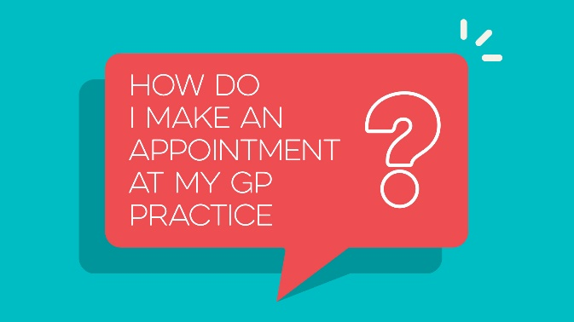
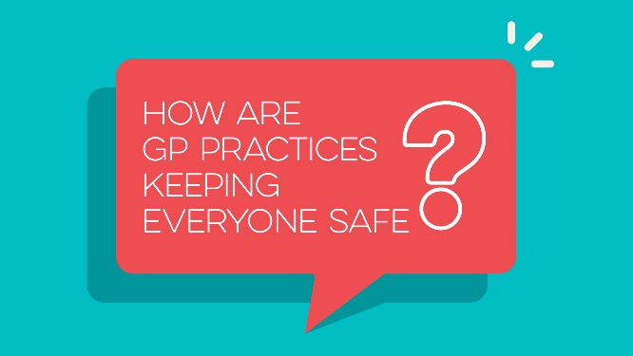
GP - Images
Click here to download GP social images.

Slide 11
GP Practice - Copy
Coronavirus has changed the way all our health services work. GP practices are now open, and have been through the pandemic, but services are being delivered differently.
If you need an appointment, contact your GP practice. It may be something you can safely manage yourself, so you may want to get advice from the NHS Inform website, or your local pharmacist, before getting in touch.
Most appointments are being carried out over the phone, or through NHS Near Me, but if you need a physical examination, you’ll need to see your GP in person. Practice staff will let you know the options available to you when you call.
If you have a face to face appointment, your GP practice will look a bit different, but please follow the guidance to help reduce the risk of infection.
These changes are in place to protect you, your family and staff. Thank you for your patience and understanding.
For more information visit nhsinform.scot/gp

Slide 12
CARE NAVIGATION IN GENERAL PRACTICE: 10-STEP GUIDE
Introduction
Effective care navigation is an essential component in delivering co-ordinated, person-centred care and support. There is no universal definition of care navigation or a ‘care navigator’ but essentially, it gives people options to access the care and information that best meets their health and social care needs. Care navigation also makes best use of appointments and resources within GP practices and the wider primary and care systems, which is always important and ever more so during the COVID-19 pandemic.
Background
Since March 2018, the ihub’s Practice Administrative Staff Collaborative (PASC) has worked with over 200 practice across Scotland to develop, test and scale up safe and effective care navigation processes within GP practices using quality improvement methods and shared learning opportunities. This guide brings together the key processes, resources and insights developed through PASC’s work into one, concise document. It is designed to support practice teams to either set up their care navigation processes or rapidly review existing processes to improve patient outcomes and sustain practice resilience and sustainability.
About this resource
Setting up care navigation processes in your practice is straightforward and this guide outlines the essential steps required. For additional support, this guide is accompanied by an introductory launch webinar, and a series of follow-up virtual workshops along with access to practical bespoke support. For further details about the support available email: his.pcpteam@nhs.scot .
The guide also signposts to a series of other related materials produced by our national partners including Scottish Government, NHS Scotland, NHS Education Scotland, NHS Inform and NHS Near Me. For the full Care Navigation Toolkit click on this link.
01
How ready is your practice for care navigation?
02
What do your team currently know about care navigation?
03
What do patients know about care navigation & local services?
04
What care navigation is already happening in your practice?
05
Who else could you navigate to in your practice and local area?
06
Which services will you start navigating to?
07
How will you navigate safely and effectively to other services?
08
Have your team all the skills they need?
09
How will your patients know about your new navigation systems?
10
How will you know your new processes work for everyone?

Slide 13
CARE NAVIGATION IN GENERAL PRACTICE: 10-STEP GUIDE
How ready is your practice for care navigation?
Readiness Assessment
Enablers and Barriers
How to Brainstorm Solutions and Achieve Consensus
01
There may never be a perfect time to introduce a new way working but the benefits of introducing care navigation are significant and worth the effort - click here to learn what care navigation is and here to see how it can make a difference.
Use the Readiness Assessment template to identify any possible barriers to getting started, then review the Enablers & Barriers document for ideas and resources to help you quickly overcome any immediate obstacles, or try brainstorming your own solutions using this Brainstorming Guide
What do your team currently know about care navigation?
Care Navigation Staff Questionnaire
02
Check in with your team members and clarify their current understanding of care navigation and confidence in doing it.
They may need further support and development which can be delivered in a range of ways (see Step 7 for more details)
At this stage, it is important to emphasise that care navigation is not the same as clinical triage.
What do patients know about care navigation & local services?
Patient Survey to patient feedback.
When possible ask patients to fill out the survey while in the waiting room.
Alternatively, email the survey, post on your website or social media platform.
03
It’s important to gain a sense of what your patients know about services available to them both in and outwith the practice.
This will help you make decisions around which services you choose to care navigate to and how.
Use the Patient Survey to gather feedback – you can use hard or electronic copies to best suit your patients’ needs (and in line with current COVID-19 restrictions).
What care navigation is already happening in your practice?
There is no “one-size fits all” approach to care navigation and your processes need to fit your local context.
You may already be doing some or more care navigation than you realise.
Use this tally sheet to count who you are already navigating to. If time allows, complete the count over a full week or select a
known busy day (e.g. Monday) to get the best indication of your current care navigation activity.
Next, create your own flowchart to map out your current or future care navigation pathways - this example flowchart will
help you get started.
Care Navigation Tally Sheet
Care Navigation Flowchart Example
04
Who else could you navigate to in your practice and local area?
Care Navigation Guidelines Template
Scotland’s Service Directory
05
Remember to include services/professionals from both inside and outside your practice and find out what services they deliver, how they deliver them and when so that you can offer patients accurate advice and guidance.
Invest the time to have conversations with your partner professionals and services to develop your care navigation pathways – click here for example Care Navigation Guidelines templates you can use to fact find about your local services and develop your own local guidelines for your reception team.
More information about services in your local area is available on NHS Inform’s Scotland’s Service Directory

Slide 14
CARE NAVIGATION IN GENERAL PRACTICE: 10-STEP GUIDE
Which services will you start navigating to?
Having worked through Step 4 you should now know which services are available in your area, this knowledge will help you prioritise which services to navigate to.
It may be easier to begin by prioritising the most frequently accessed services first to allow staff and patients time to adjust to this new way of working.
All team members can benefit from meeting with your partner services to build relationships and awareness of services.
You need to have professional links with service providers
A meeting/call to discuss how best to collaborate is essential.
“Meet the Expert” sessions to connect with a local providers can be of benefit
06
How will you navigate safely and effectively to other services?
For each service you want to navigate to, you will need to develop a navigation criteria summary for your administrative team to follow, this is the same template you used to find out about your local services so the work is nearly done.
The criteria should be completed with the clinical professional, the Practice Manager, a receptionist and ideally a GP.
If your IT systems allow you can link these criteria summaries to your EMIS template or Vision guidelines.
It’s recommended you contact your indemnity provider and notify them of your new processes before you get started.
Care Navigation Guidelines Template
Pharmacy First Practice Guidance provides specific care navigation to “Pharmacy First”
NHS Inform’s Your Community Health Care Services campaign
07
Have your team all the skills they need?
In-Practice Learning & Communications
External Training Providers
NES TURAS Learn
08
Use a blend of existing practice expertise, wider local collaboration and national support to meet the needs of your team.
Use the skills and experience within your whole team and wider community to develop your own in-house opportunities for learning and sharing.
Consider any gaps team members may have in their “softer skills” too, e.g. communication, active listening, handling difficult conversations – search the NES TURAS Learn site for learning materials and resources
How will your patients know about your new navigation systems?
Example practice phone messages
Display NHS Inform key patient guidance about service provision on practice notice boards/social media & websites
Example posters 1, 2 & 3 to use to develop your own customised patient notices.
09
To avoid confusion and provide reassurance, communicate your new care navigation procedures to patients effectively.
Ensure you agree a start date with your selected services so they can anticipate any change in demand and plan ahead.
It may take time for your patients to understand why things have changed - understanding and patience will support this.
If your patient does not wish to be navigated, elsewhere always offer them access to a GP – this is their choice.
Use a range of different ways to get your message across to maximise reach and uptake.
How will you know your new systems work for everyone?
Identify team members to review, test and update your care navigation framework.
Use check-in questionnaires with your patients and team members to gather feedback.
Use this review template to reflect on your activity and continuously improve.
10
Care navigation is an ongoing process and regular reviews and updates on progress and processes.
Remember to consult regularly with internal team members, external community colleagues and patients to ensure your processes are working for everyone involved.
Safety is essential, so if ongoing issues arise or you anticipate any safety concerns, review and revise your plans immediately.
And finally, remember to celebrate your success and the difference it has made for your patients, partners and team members.

Slide 15
Optometry
The following film has been added to NHSInform. This can be used through any digital communication channels you have available
You can also link directly to specific sections of the film via the following links:
EDIT 1: What’s an eye examination appointment for?
EDIT 2: How do I make an appointment with an optometrist?
EDIT 3: How are opticians keeping everyone safe?
EDIT 4: Thank you for your patience and understanding
https://youtu.be/1srcOkaJArQ
https://youtu.be/1srcOkaJArQ?t=11
https://youtu.be/1srcOkaJArQ?t=40
https://youtu.be/1srcOkaJArQ?t=79
https://youtu.be/1srcOkaJArQ?t=152

Slide 16
Optometry – Social Content
EDIT 1: What’s an eye examination appointment for?
POST 1: If you have an eye problem, you should always contact your optometry practice (opticians) first. All opticians are now open and providing routine eye care services. Find out more here: nhsinform.scot/optometry
EDIT 2: How do I make an appointment with an optometrist?
POST 2: Optometry services (opticians) may be delivered in a different way during the pandemic, but it’s important to call and make an appointment if you have an eye problem, or are due a routine eye examination. Find out more here: nhsinform.scot/optometry
EDIT 3: How are optometry practices (opticians) keeping people safe?
POST 3: Unsure of what to expect at your next opticians appointment? Find more about the measures in place to help keep you safe, and what you may be asked to do here: nhsinform.scot/optometry
EDIT 4: Thank you for your patience and understanding
POST 4: Your patience whilst accessing NHS services is appreciated. Find your nearest optometry practice (opticians) here: nhsinform.scot/optometry

Slide 17
Optometry - Images
Click here to download optometry social images.

Slide 18
Optometry - Copy
Coronavirus has changed the way all our health services work. All optometry practices (opticians) are now open, but services will be delivered differently during the pandemic.
If you have an eye problem, you should always contact your opticians first. It’s also important to have a regular NHS-funded eye examination as this can help to detect any eye problems and signs of other significant health conditions before they become more serious.
Due to physical distancing and infection control measures, opticians can only offer a certain amount of appointments each day, and priority will be given to people with emergency or essential eye problems.
When attending your appointment, your opticians will look a bit different, but please follow the guidance to help reduce the risk of infection.
These changes are in place to protect you, your family and staff. Thank you for your patience and understanding.
For more information visit nhsinform.scot/optometry

Slide 19
Pharmacy
The following film has been added to NHSInform. This can be used through any digital communication channels you have available
You can also link directly to specific sections of the film via the following links:
EDIT 1: What can a pharmacy help me with?
EDIT 2: Do I have to visit the pharmacy in person?
EDIT 3: What health and safety measures are in place?
EDIT 4: Thank you for your patience and understanding
https://youtu.be/VlwmZ9wGKZg
https://youtu.be/VlwmZ9wGKZg?t=13
https://youtu.be/VlwmZ9wGKZg?t=95
https://youtu.be/VlwmZ9wGKZg?t=149
https://youtu.be/VlwmZ9wGKZg?t=210

Slide 20
Pharmacy – Social Content
EDIT 1: What can a pharmacy help me with?
POST 1: If you have a minor illness, your pharmacy is the first place you should go for advice and treatment. Find information on symptoms and self-help guides here: nhsinform.scot/self-help-guides
EDIT 2: Do I have to visit the pharmacy in person?
POST 2: Pharmacies are open with measures in place to ensure your safety. Here we explain how you can access help from a pharmacist during the coronavirus pandemic. Find out more at: nhsinform.scot/pharmacy
EDIT 3: What health and safety measures are in place?
POST 3: When visiting your local pharmacy, you’ll be asked to wear a face covering, use hand sanitiser and keep a two metre distance from others. Here, we explain the measures in place to help keep people safe. Find more information at: nhsinform.scot/pharmacy
EDIT 4: Thank you for your patience and understanding.
POST 4: Your patience and understanding whilst accessing NHS services is appreciated. Find your nearest community pharmacy here: nhsinform.scot/scotlands-service-directory

Slide 21
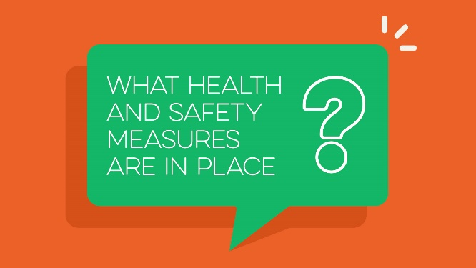
Pharmacy - Images
Click here to download pharmacy social images.

Slide 22
Pharmacy - Copy
Coronavirus has changed the way all our health services work. Community pharmacies are open, with the NHS Pharmacy First Scotland Service now available to everyone.
If you have a minor illness, your pharmacy is the first place you should go for advice and treatment, after using the self-help guides on the NHS Inform website.
The pharmacy team will be able to give you advice on how to manage your condition, and if necessary, will supply you with NHS treatment.
To comply with physical distancing measures, only a limited number of people will be allowed inside the pharmacy, and you will be asked to follow the guidance to help reduce the risk of infection.
These changes are in place to protect you, your family and staff. Thank you for your patience and understanding.
For more information visit nhsinform.scot/pharmacy

Slide 23
Mental Health - Copy
Mental health and wellbeing services are available providing free support for a range of conditions such as stress, anxiety, depression, feelings of panic, and help for people of all ages who are experiencing distress and in need of immediate response. This includes support for issues arising from the coronavirus pandemic.
Your GP Practice is open and available to help but please remember to make an appointment first.
Telephone support – If you're struggling with your mental health or need emotional support you can call:
Breathing Space on 0800 83 85 87 open weekdays Monday - Thursday 6pm to 2am and weekends Friday 6pm - Monday 6am. You can also visit breathingspace.scot
For urgent support please call NHS 24 on 111, 24 hours a day
There are online resources to help with your mental health, whether you're looking for advice, information, local support, or ideas for improving your wellbeing, visit NHSinform.scot/mentalhealth
For tips on how to get through difficulties arising from the coronavirus pandemic go to clearyourhead.scot

Slide 24
Mental Health – Social Content
Edit 1: What do I do if I need emotional support, or help with my mental health?
Post 1: Your GP practice is open and available to help, please make an appointment first. You can also find support online and by phone here: nhsinform.scot/youmatterwecare
Edit 2: The pandemic is making me feel very stressed and anxious, what can I do?
Post 2: These are worrying and uncertain times. It's ok to not feel yourself right now, and we have some great tips to help here: clearyourhead.scot/
Click here to access the Clear Your Head Stakeholder and Partner Resources

Slide 25
NHS Pharmacy First Scotland Key Messages
If you have a minor illness, a pharmacy is the first place you should go for advice.
The Pharmacy First service is quick and convenient, and can save you a trip to the GP practice.
You can go to any local community pharmacy and in most cases you do not need to make an appointment first.
You can use this service if you live in Scotland or are registered with a GP in Scotland.
Your local pharmacist or a trained member of the pharmacy team will give you advice and provide medicine if needed. This can include prescription medicines in some cases.
The service is confidential, and many community pharmacies now offer private consulting spaces.
Your pharmacist can refer you to another healthcare professional such as your GP practice, dentist, optometrist or another NHS service if they feel your condition needs further investigation or more specialist care.
For more details see NHS Inform (where you can also find guidance on self-help for a range of common conditions):
https://www.nhsinform.scot/care-support-and-rights/nhs-services/pharmacy/nhs-pharmacy-first-scotland

Slide 26
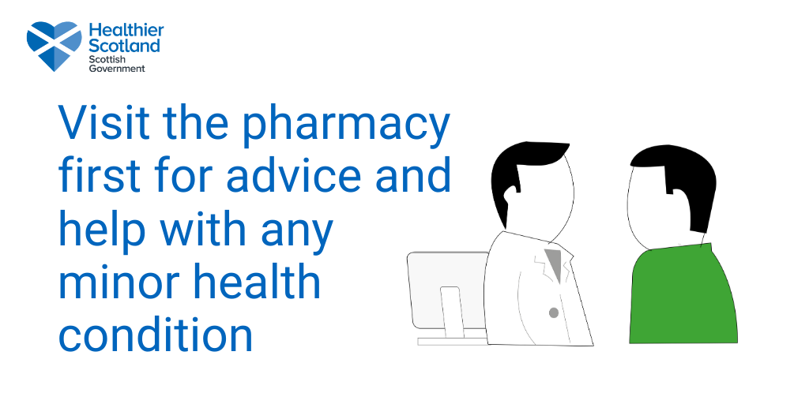
NHS Pharmacy First Scotland - Graphic

Slide 27
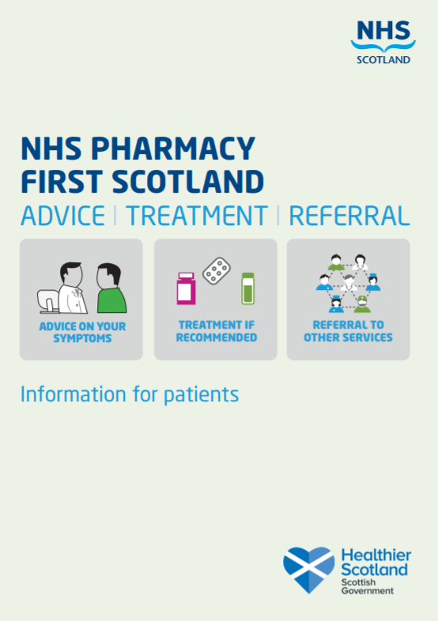
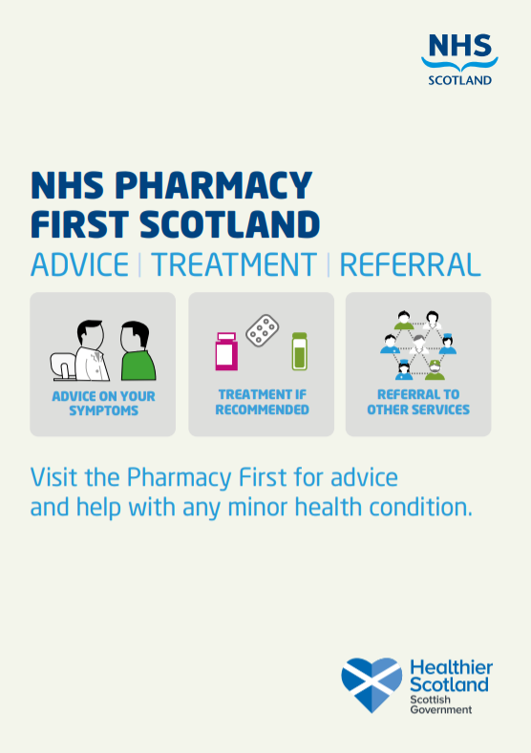
NHS Pharmacy First Scotland - Materials
Pharmacy First leaflet
Pharmacy First Poster

Slide 28
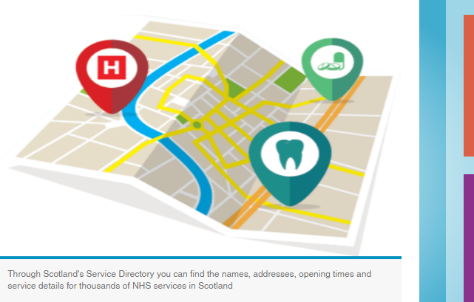
Scotland’s Service Directory
Scotland’s Service Directory has been developed by NHS 24 in partnership with Macmillan Cancer Support and The Alliance. The directory is available on NHS inform - nhsinform.scot/scotlands-service-directory
The directory aims to provide a localised online directory of quality-assured health and care services across all regions in Scotland.
Health care professionals and members of the public can visit the directory and access information on where to find local NHS services, including pharmacies, opticians, dental practices and sexual health clinics.
In addition to NHS services, the directory also provides information on a wide range of health and wellbeing services, including advice on how to stay active, cancer services and money advice.
Suggested content to promote Scotland’s Service Directory to your patients:
Facebook: Do you know where local health and well-being services are and how to contact them? Try Scotland's Service Directory. Developed with NHS 24, Macmillan Cancer Support and the Health and Social Care Alliance (The Alliance) to bring you an easy to access directory of local services. From your Emergency Department to a local Dementia Cafe, your first place to look is Scotland's Service Directory. www.nhsinform.scot/scotlands-service-directory
Twitter: Through Scotland's Service Directory you can find the names, addresses, opening times and service details for your local health and well-being services. Developed with @macmillancancer and @ALLIANCEScot it's your first place to look for services. www.nhsinform.scot/scotlands-service-directory

Slide 29
For more information, please contact: Anna Dougherty E: Anna.Dougherty@gov.scot

